Slide 1
Employee Data Analysis using Excel
STUDENT NAME: KISHORE S
REGISTER NO: 312214519/19C48939E28954591C84EE77A6A42A4F
DEPARTMENT: B.COM COMPUTER APPLICATION
COLLEGE: ST.THOMAS COLLEGE OF ARTS AND SCIENCE

Slide 2
PROJECT TITLE
USING PIVOT TABLES FOR EMPLOYEE TURNOVER ANALYSIS

Slide 3


AGENDA
Problem Statement
Project Overview
End Users
Our Solution and Proposition
Dataset Description
Modelling Approach
Results and Discussion
Conclusion
3/21/2024 Annual Review

Slide 4

PROBLEM STATEMENT
The Human Resources department is experiencing challenges in understanding and managing employee turnover within the organization.
Current methods of data analysis are insufficient in identifying key trends and patterns related to turnover, such as which departments, job roles, or demographic groups are most affected.
This lack of insight hampers the ability to develop targeted retention strategies.

Slide 5

PROJECT OVERVIEW
Employee turnover is a critical issue for organizations, affecting productivity, morale, and financial performance.
Understanding the factors contributing to turnover is essential for developing effective retention strategies.
This project aims to leverage pivot tables to analyze employee turnover data.
providing insights into patterns and trends that can inform decision-making within the Human Resources (HR) department.

Slide 6

WHO ARE THE END USERS?
1.Human Resources (HR) Team:
• HR Analysts: Responsible for conducting the analysis and presenting the findings
• HR Managers: Interested in understanding the turnover trends to implement strategic initiatives.
2.HR Directors and Executives:
• HR Directors: Oversee the overall HR strategy and need the insights to align turnover management with organizational goals.
• Chief HR Officer (CHRO): Utilizes the data to guide company-wide HR policies and strategies.
3.Department Heads and Managers:
• Managers: Need to understand turnover trends within their teams to address specific issues and improvement

Slide 7

OUR SOLUTION AND ITS VALUE PROPOSITION
1. Streamlined Data Organization: - Pivot tables allow you to consolidate and organize large volumes of HR data efficiently. - Simplifies the process of categorizing turnover data by departments, roles, tenure, and other key metrics.
2. Dynamic Analysis Capabilities: - Enables easy filtering and sorting of data to identify patterns, trends, and anomalies in employee turnover. - Allows for quick adjustments and comparisons, such as turnover rates by department, time period, or employee demographics.
3. Real-Time Insights and Reporting: - Facilitates the creation of real-time, up-to-date reports that can be easily shared with stakeholders. - Empowers HR teams to make data-driven decisions quickly by visualizing turnover data in various formats (e.g., charts, graphs).
4. Cost-Effective Solution: - Uses widely available tools (Excel, Google Sheets) that require minimal additional investment. - Reduces the need for expensive third-party analytics software or consultants.

Slide 8
Dataset Description
Employee=KAGGLE
26-Features
9-Features
Emp Id-Number
Name Text
Emp-Type
Current Employee Rating-Number
Gender-Male Female
Employee Rating-Number

Slide 9

THE "WOW" IN OUR SOLUTION
=IFS(Z8>=5,”VERY HIGH”,Z8>=4,”HIGH”,Z8>=3,”MED”,TRUE,”LOW”)
3/21/2024 Annual Review
9

Slide 10
MODELLING
Step 1: Prepare Your DataBefore using a pivot table, ensure your data is structured properly. Your dataset should include at least the following columns:- *Employee ID*: A unique identifier for each employee.- Department: The department the employee belongs to.- *Hire Date*: The date the employee was hired.- *Termination Date*: The date the employee left the company, if applicable.
Step 2: Create a Pivot Table1. *Insert Pivot Table*: Select your data and insert a pivot table. You can do this by going to the "Insert" tab and selecting "Pivot Table."2. *Drag and Drop Fields*: Start by dragging and dropping the fields into the appropriate areas: - *Rows*: Drag the "Department" and "Status" fields here to analyze turnover by department. - *Values*: Drag the "Employee ID" field here and set it to count the number of employees. - *Columns*: You could drag the "Status" field here to compare active vs. terminated employees side-by-side. - *Filters*: You could add.
Step 3: Calculate Employee Turnover RateTo calculate the turnover rate:1. *Insert a Calculated Field*: Go to the Pivot Table Analyze tab, and select "Fields, Items, & Sets" > "Calculated Field."2. *Formula*: Use a formula like this to calculate the turnover rate: \[ \text{Turnover Rate} = \frac{\text{Terminated Employees}}{\text{Total Employees
Step 4: Analyze the Results- By Department: See which departments have the highest turnover rates.- *By Tenure*: Analyze if employees with certain tenures are more likely to leave.- *By Reason*: Understand the primary reasons for employee turnover.
Step 5: Visualize the Data- *Pivot Charts*: Use pivot charts to create visual representations of the data, like bar charts or pie charts, to compare turnover rates across departments or time periods.- *Trend Analysis*: Use line charts to observe how turnover rates have changed over time.
10

Slide 11
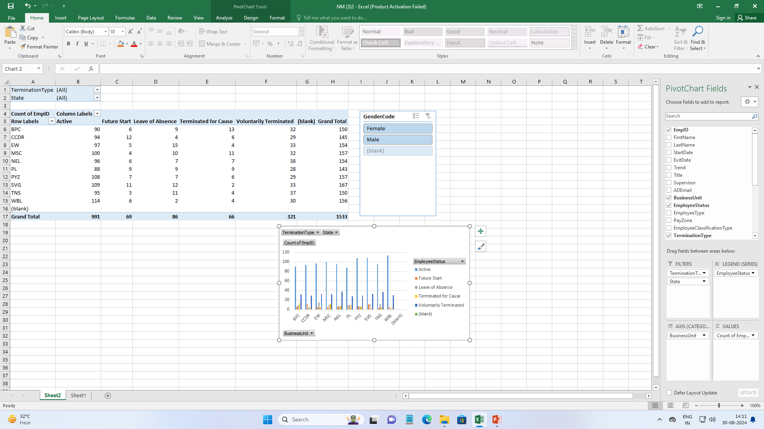
RESULTS
11

Slide 12
RESULTS

Slide 13
conclusion
In conclusion, pivot tables are a powerful tool for analyzing employee turnover, providing a clear and concise way to summarize and interpret complex data. They allow for efficient organization and visualization of turnover metrics, such as rates by department, reasons for leaving, and tenure trends. By leveraging pivot tables, organizations can identify key patterns and insights that inform strategic decisions on improving employee retention, addressing departmental issues, and enhancing overall workforce stability. This analytical approach ultimately supports data-driven decision-making, helping to create a more resilient and effective organization.

